Slide 1
ANALOGUE METERS
By
Candida Nakida Mwisomba

Slide 2
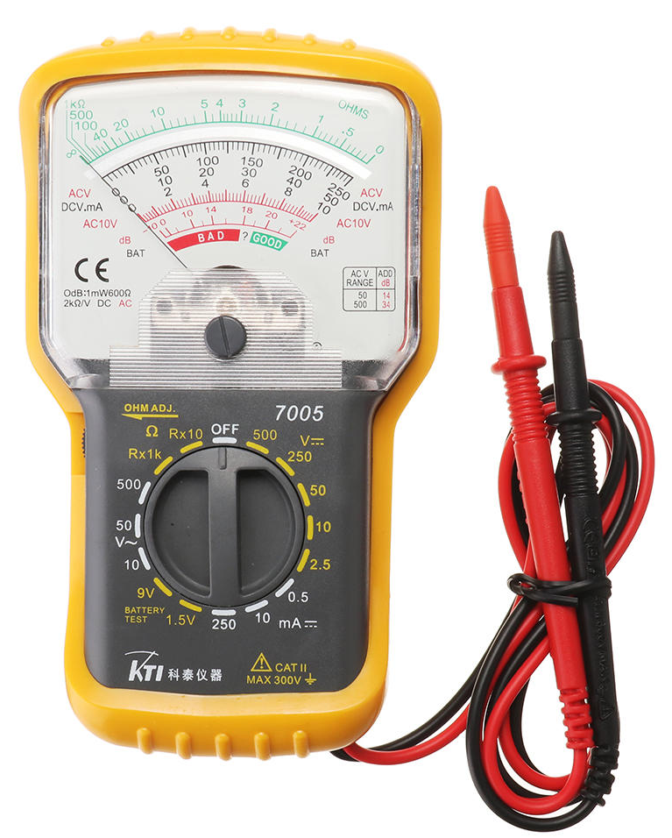
ANALOG ELECTRONIC MEASURING METERS

Slide 3
Outline
Basic principles
DC Voltmeters,
AC Voltmeters,
DC Ammeters,
AC Ammeters,
Ohmmeters

Slide 4
Analogue meters
Analogue meters are electromechanical devices that drive a pointer against a scale.
They are prone to measurement errors from a number of sources that include inaccurate scale marking during manufacture, bearing friction, bent pointers and ambient temperature variations.
Further human errors are introduced through parallax error (not reading the scale from directly above) and mistakes in interpolating between scale markings.

Slide 5
Moving-coil meters
A moving-coil meter is a very commonly used form of analogue voltmeter because of its sensitivity, accuracy and linear scale, although it only responds to d.c signals.
It consists of a rectangular coil wound round a soft iron core that is suspended in the field of a permanent magnet. The signal being measured is applied to the coil and this produces a radial magnetic field.
Interaction between this induced field and the field produced by the permanent magnet causes a torque, which results in rotation of the coil.
The amount of rotation of the coil is measured by attaching a pointer to it that moves past a graduated scale.

Slide 6
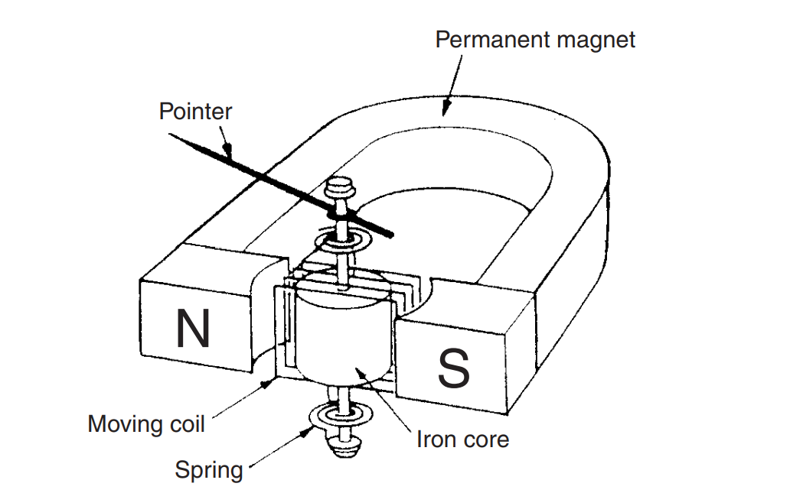
Moving-coil meters…

Slide 7
Moving-coil meters…
As the basic instrument operates at low current levels of one milliamp or so, it is only suitable for measuring voltages up to around 2 volts.
If there is a requirement to measure higher voltages, the measuring range of the instrument can be increased by placing a resistance in series with the coil, such that only a known proportion of the applied voltage is measured by the meter.
In this situation the added resistance is known as a shunting resistor.

Slide 8
Moving-iron meters
As well as measuring d.c signals, the moving-iron meter can also measure a.c. signals at frequencies up to 125 Hz.
It is the cheapest form of meter available and, consequently, this type of meter is also commonly used for measuring voltage signals.
The signal to be measured is applied to a stationary coil, and the associated field produced is often amplified by the presence of an iron structure associated with the fixed coil.
The moving element in the instrument consists of an iron vane that is suspended within the field of the fixed coil. When the fixed coil is excited, the iron vane turns in a direction that increases the flux through it.

Slide 9
Moving-iron meters…
The instrument can typically measure voltages in the range of 0 to 30 volts. However, it can be modified to measure higher voltages by placing a resistance in series with it, as in the case of moving coil meters.
A series resistance is particularly beneficial in a.c signal measurements because it compensates for the effect of coil inductance by reducing the total resistance/inductance ratio, and hence measurement accuracy is improved.

Slide 10
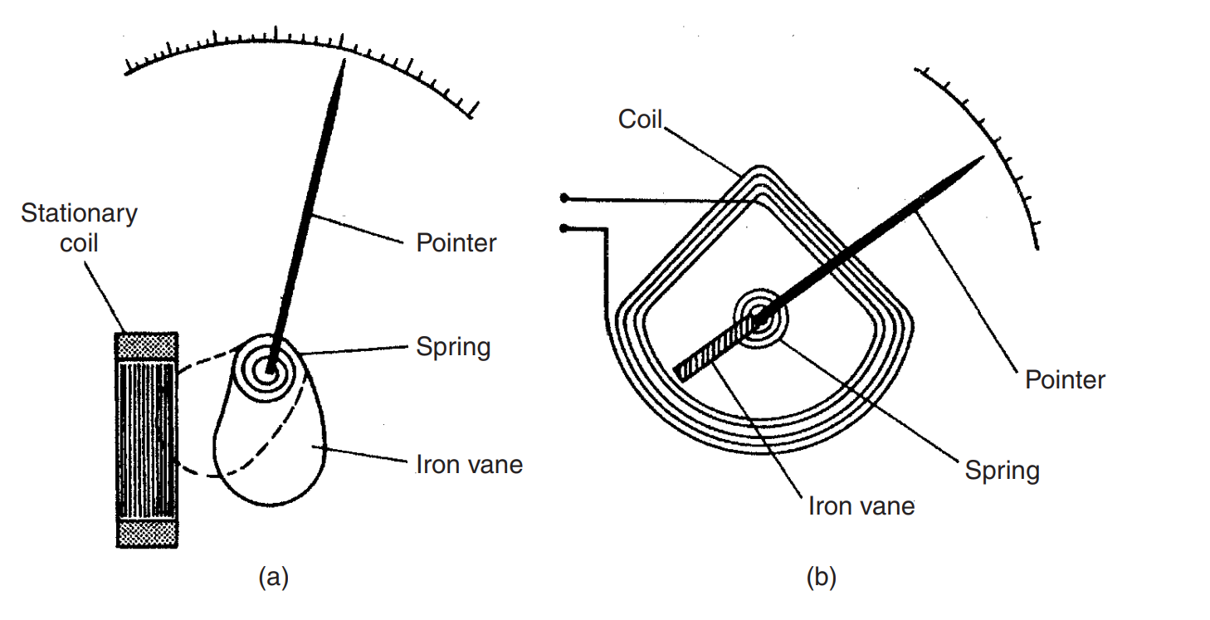
Moving-iron meters…
Attraction type
Repulsion type

Slide 11
Basic meter
A basic d.c meter uses a monitoring principle for its operation.
It states that any current carrying coil placed in a magnetic field experiences a force, which is proportional to the magnitude of current passing through the coil.
This movement of the coil is called D’Arsonval movement and basic meter is called D’Arsonval galvanometer.

Slide 12
DC instruments
(a)Using shunt resistance, d.c current can be measured.
The instrument is d.c microammeter, milliammeter or ammeter.
(b)Using series resistance called multiplier, d.c voltage can be measured.
The instrument is d.c millivoltmeter, voltmeter or kilovoltmeter
(c)Using a battery and resistive network, resistance can be measured.
The instrument is ohmmeter.

Slide 13
AC instruments
(a)Using a rectifier, a.c voltages an be measured, at power and audio frequencies.
The instrument is a.c voltmeter
(b)Using a thermocouple type meter radio frequency (RF) voltage or current can be measured.
(c)Using a thermistor in a resistive bridge network, expanded scale for power line voltage can be obtained.

Slide 14
Basic DC voltmeter
The basic d.c voltmeter is nothing but a permanent magnet moving coil (PMMC) D’ Arsonval galvanometer.
The resistance is required to be connected in series with the basic meter to use it as a voltmeter.
This series resistance is called multiplier.
The main function of the multiplier is to limit the current through the basic meter so that the meter current does not exceed the full scale deflection value.
The voltmeter measures the voltage across the two points of a circuit or a voltage across a circuit component.

Slide 15
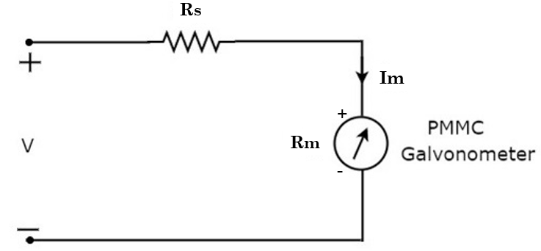
Basic dc voltmeter
We have to place this DC voltmeter with proper polarity across the two points of an electric circuit, where the DC voltage is to be measured.

Slide 16
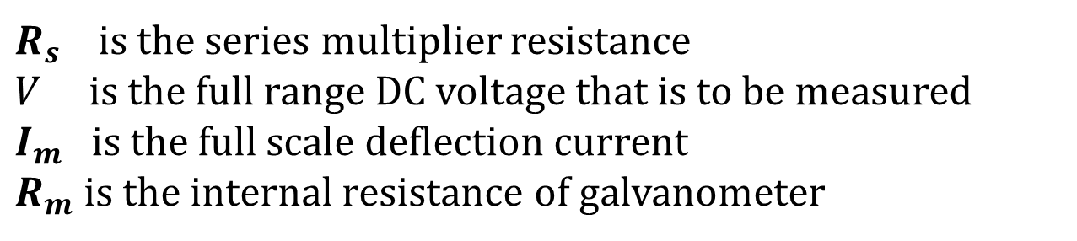
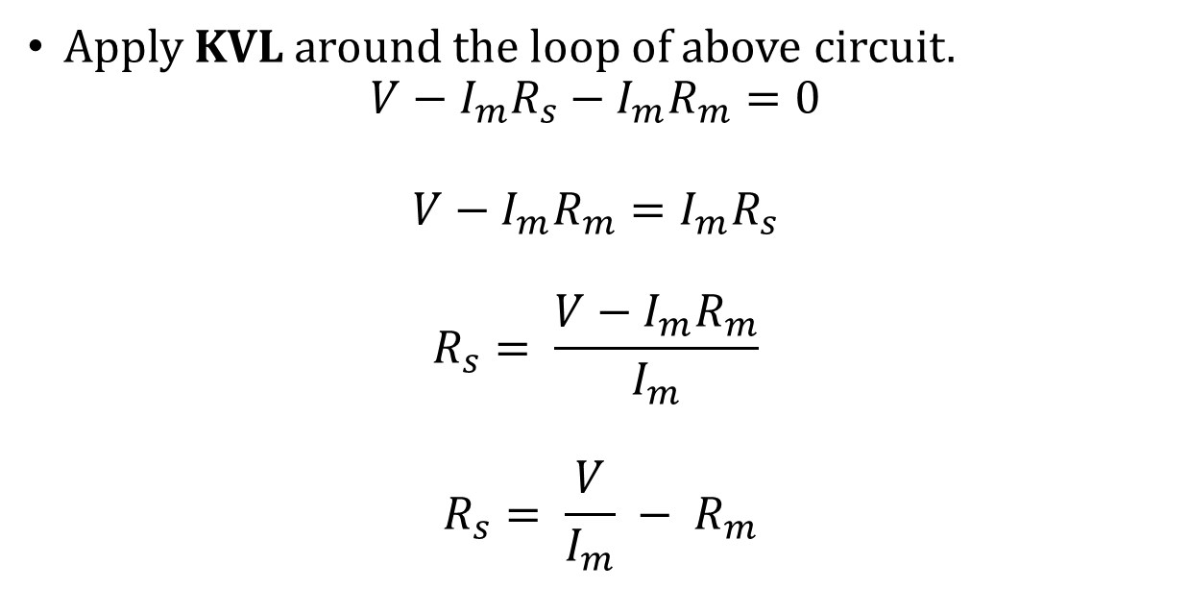
Basic dc voltmeter
Apply KVL around the loop of above circuit.
$$V−I_{m}R_{s}−I_{m}R_{m}=0$$
$$V−I_{m}R_{m}=I_{m}R_{s}$$
$$R_{s}= \frac{V−I_{m}R_{m}}{I_{m}}$$
$$R_{s}= \frac{V}{I_{m}} −{ R}_{m}$$
$R_{s}$ is the series multiplier resistance
$V$ is the full range DC voltage that is to be measured
$I_{m}$ is the full scale deflection current
$R_{m}$ is the internal resistance of galvanometer

Slide 17
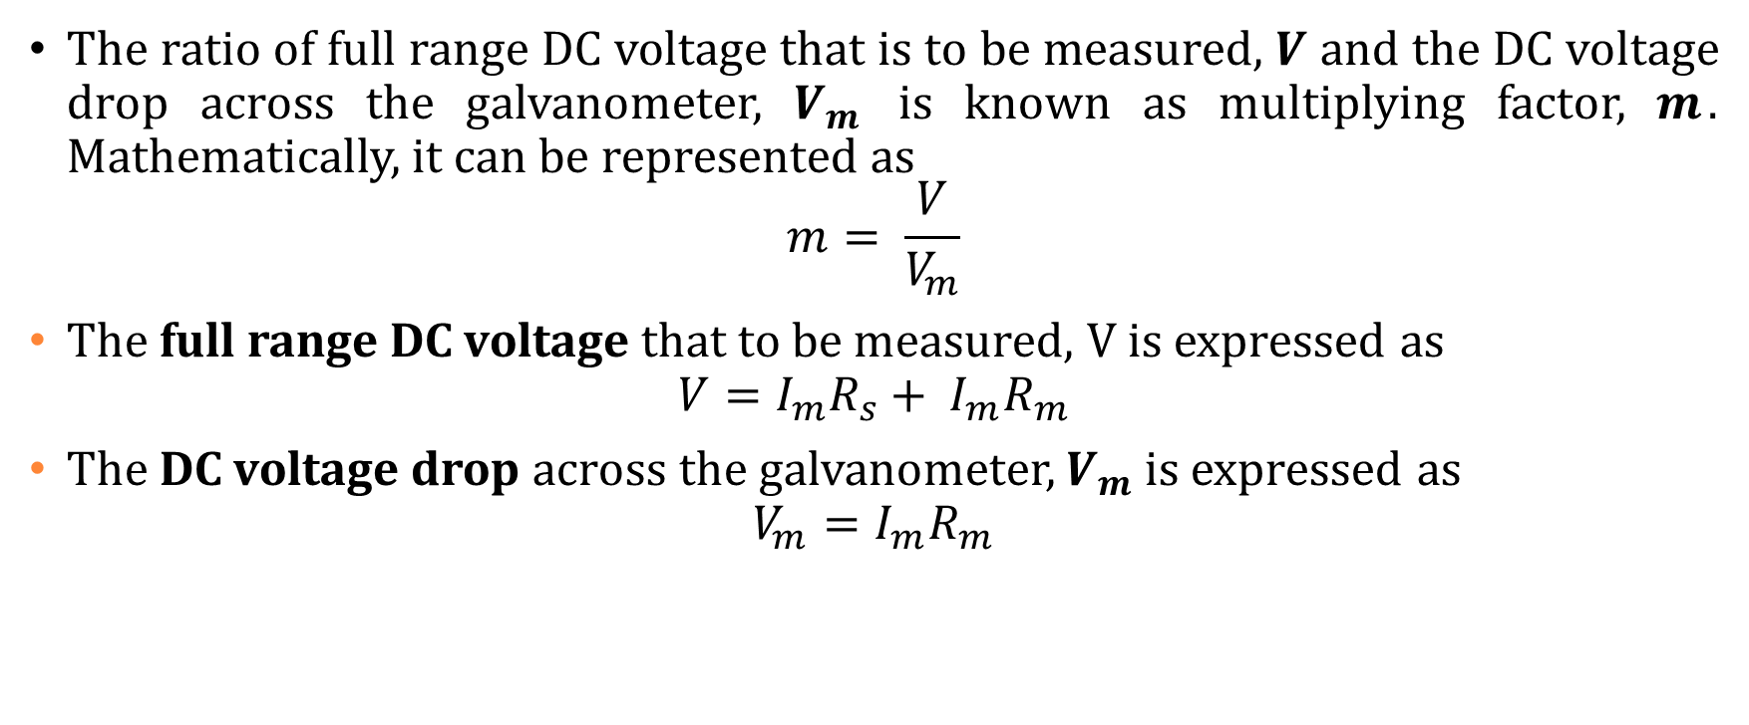
Basic dc voltmeter
The ratio of full range DC voltage that is to be measured, $V$ and the DC voltage drop across the galvanometer, $V_{m}$ is known as multiplying factor, $m$. Mathematically, it can be represented as
$$m= \frac{V}{V_{m}}$$
The full range DC voltage that to be measured, V is expressed as
$$V=I_{m}R_{s}+ I_{m}R_{m}$$
The DC voltage drop across the galvanometer, $V_{m}$ is expressed as
$$V_{m}=I_{m}R_{m}$$

Slide 18

Basic dc voltmeter
Multiplying factor, $m$ can be represented as
$m= \frac{I_{m}R_{s}+ I_{m}R_{m}}{I_{m}R_{m}}$
$$m=1+ \frac{R_{s}}{R_{m}}$$
Series multiplier resistance, $R_{s}$is now be expressed as
$$R_{s}= R_{m}\left(m−1\right)$$

Slide 19
Multirange DC Voltmeters
In previous section, we had discussed DC voltmeter, which is obtained by placing a multiplier resistor in series with the PMMC galvanometer.
This DC voltmeter can be used to measure a particular range of DC voltages.
If we want to use the DC voltmeter for measuring the DC voltages of multiple ranges, then we have to use multiple parallel multiplier resistors instead of single multiplier resistor and this entire combination of resistors is in series with the PMMC galvanometer.

Slide 20
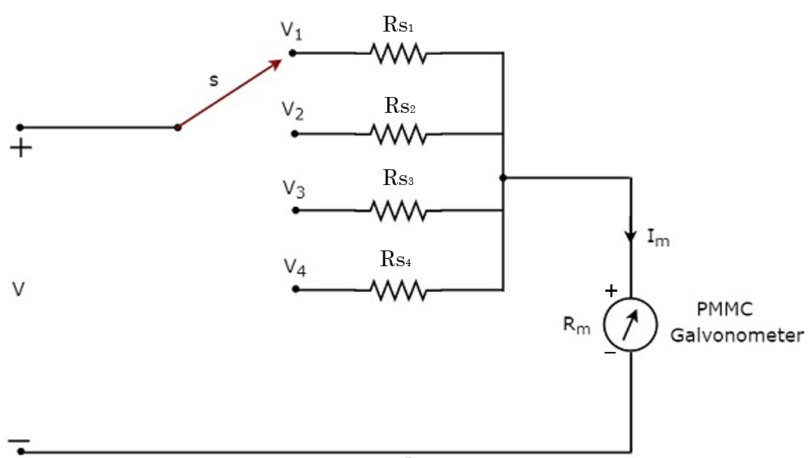
Multirange DC Voltmeters
We have to place this multirange DC voltmeter across the two points of an electric circuit, where the DC voltage of required range is to be measured.
We can choose the desired range of voltages by connecting the switch s to the respective multiplier resistor.

Slide 21
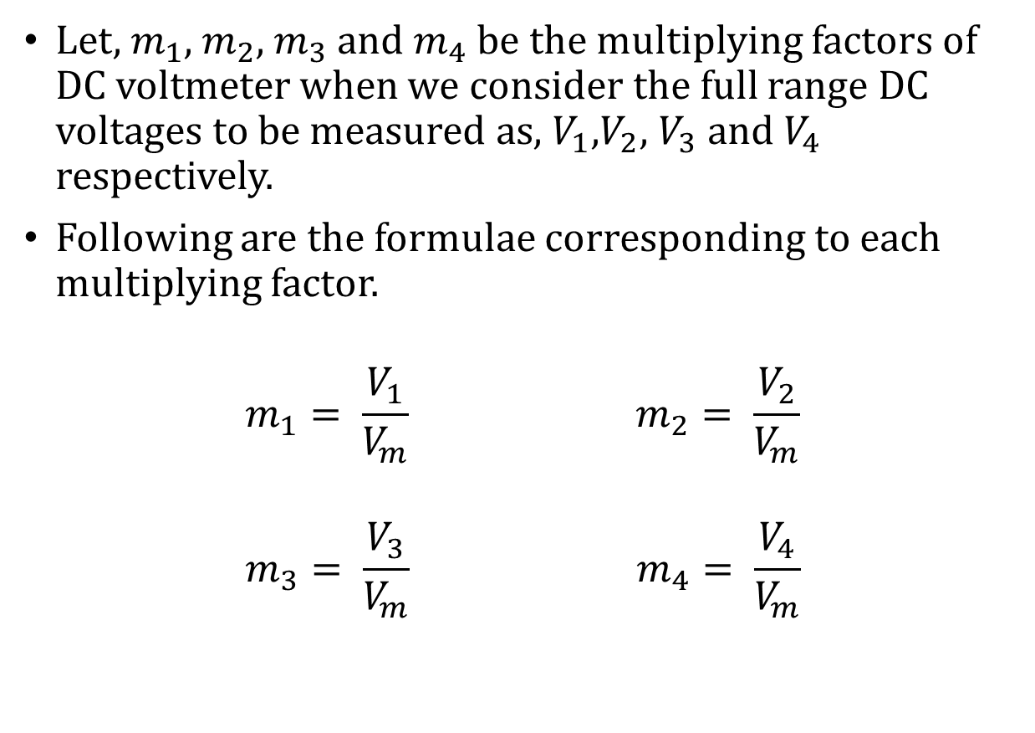
Multirange DC Voltmeters
Let, $m_{1}$, $m_{2}$, $m_{3}$ and $m_{4}$ be the multiplying factors of DC voltmeter when we consider the full range DC voltages to be measured as, $V_{1}$,$V_{2}$, $V_{3}$ and $V_{4}$ respectively.
Following are the formulae corresponding to each multiplying factor.
$$m_{1}= \frac{V_{1}}{V_{m}} m_{2}= \frac{V_{2}}{V_{m}}$$
$$m_{3}= \frac{V_{3}}{V_{m}} m_{4}= \frac{V_{4}}{V_{m}}$$

Slide 22

Multirange DC Voltmeters
Following are the formulae corresponding to these four resistors.
$$R_{s1}= R_{m}\left(m_{1}−1\right)$$
$$R_{s2}= R_{m}\left(m_{2}−1\right)$$
$$R_{s3}= R_{m}\left(m_{3}−1\right)$$
$$R_{s4}= R_{m}\left(m_{4}−1\right)$$

Slide 23
AC Voltmeters
The instrument, which is used to measure the AC voltage across any two points of electric circuit is called AC voltmeter.
If the AC voltmeter consists of rectifier, then it is said to be rectifier based AC voltmeter.
The DC voltmeter measures only DC voltages.
If we want to use it for measuring AC voltages, then we have to follow these two steps.
Step1 − Convert the AC voltage signal into a DC voltage signal by using a rectifier.
Step2 − Measure the DC or average value of the rectifier’s output signal.

Slide 24
AC Voltmeters
We get Rectifier based AC voltmeter, just by including the rectifier circuit to the basic DC voltmeter.
Types of Rectifier based AC Voltmeters
AC voltmeter using Half Wave Rectifier
AC voltmeter using Full Wave Rectifier

Slide 25
AC Voltmeters
AC Voltmeter using Half Wave Rectifier
If a Half wave rectifier is connected ahead of DC voltmeter, then that entire combination together is called AC voltmeter using Half wave rectifier.
The block diagram of AC voltmeter using Half wave rectifier is shown in below figure.
AC input Voltage
Half wave rectifier
DC Voltmeter
Meter reading output

Slide 26
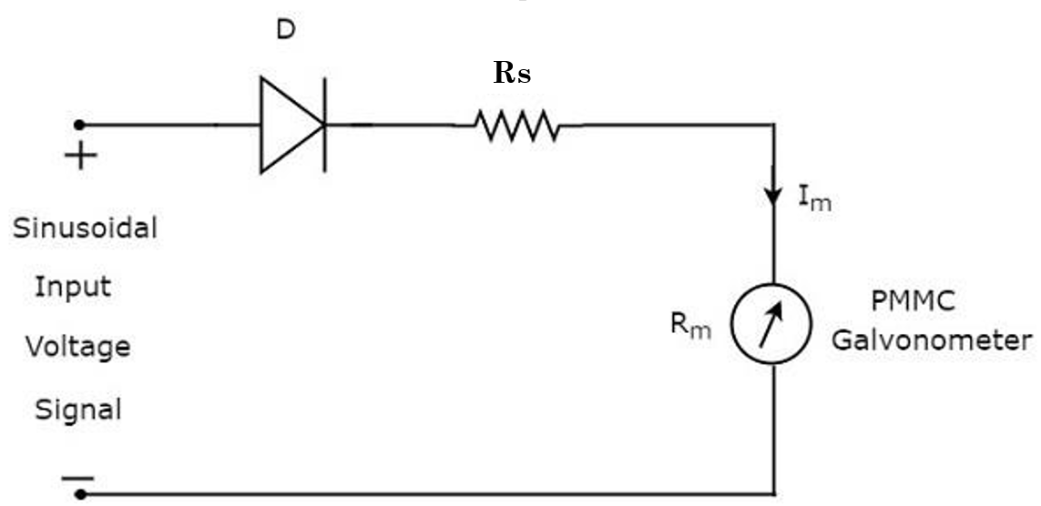

AC Voltmeters
The circuit diagram of AC voltmeter using Half wave rectifier
The rms value of sinusoidal (AC) input voltage signal is
$$V_{rms}= {V_{m}}/{\sqrt{2}}$$
$$V_{m}=1.414V_{rms}$$
$V_{m}$ is the maximum value of sinusoidal (AC) input voltage signal.

Slide 27
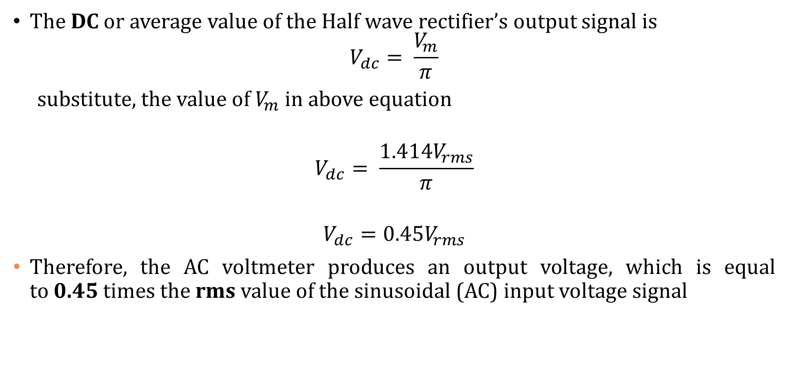
AC Voltmeters
The DC or average value of the Half wave rectifier’s output signal is
$$V_{dc}= \frac{V_{m}}{π}$$
substitute, the value of $V_{m}$ in above equation
$$V_{dc}= \frac{1.414V_{rms}}{π}$$
$$V_{dc}=0.45V_{rms}$$
Therefore, the AC voltmeter produces an output voltage, which is equal to 0.45 times the rms value of the sinusoidal (AC) input voltage signal

Slide 28
AC Voltmeters
AC Voltmeter using Full Wave Rectifier
If a Full wave rectifier is connected ahead of DC voltmeter, then that entire combination together is called AC voltmeter using Full wave rectifier.
The block diagram of AC voltmeter using Full wave rectifier is shown in below figure.
AC input Voltage
Full wave rectifier
DC Voltmeter
Meter reading output

Slide 29
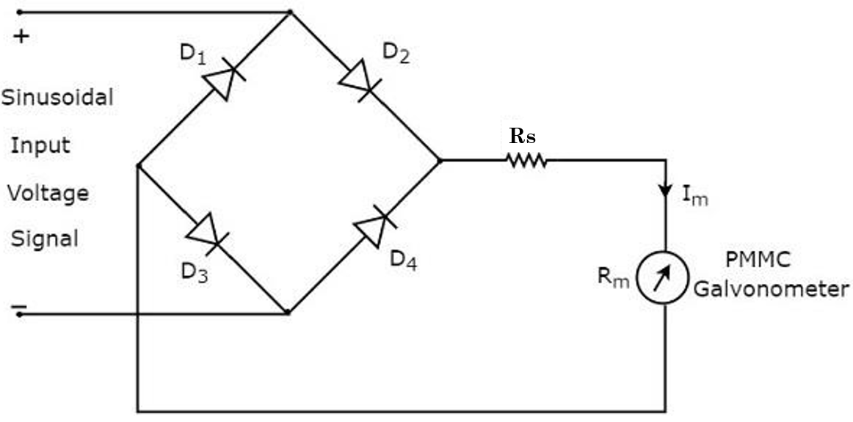
AC Voltmeters
So, the circuit diagram of AC voltmeter using Full wave rectifier will look like as shown in below figure.

Slide 30
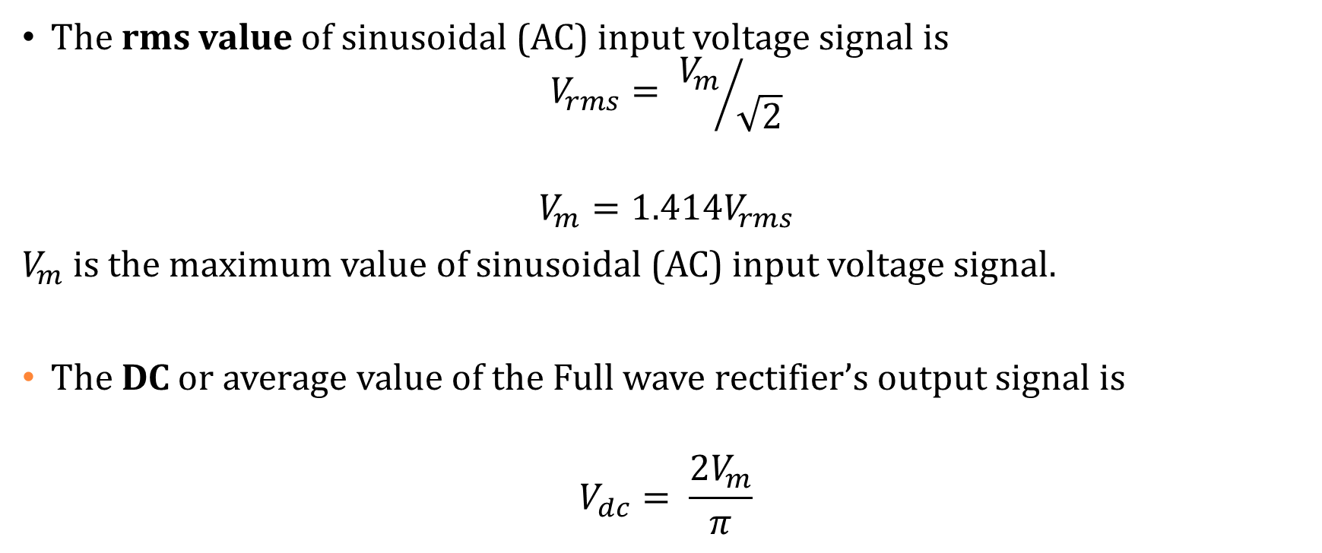
AC Voltmeters
The rms value of sinusoidal (AC) input voltage signal is
$$V_{rms}= {V_{m}}/{\sqrt{2}}$$
$$V_{m}=1.414V_{rms}$$
$V_{m}$ is the maximum value of sinusoidal (AC) input voltage signal.
The DC or average value of the Full wave rectifier’s output signal is
$$V_{dc}= \frac{2V_{m}}{π}$$

Slide 31
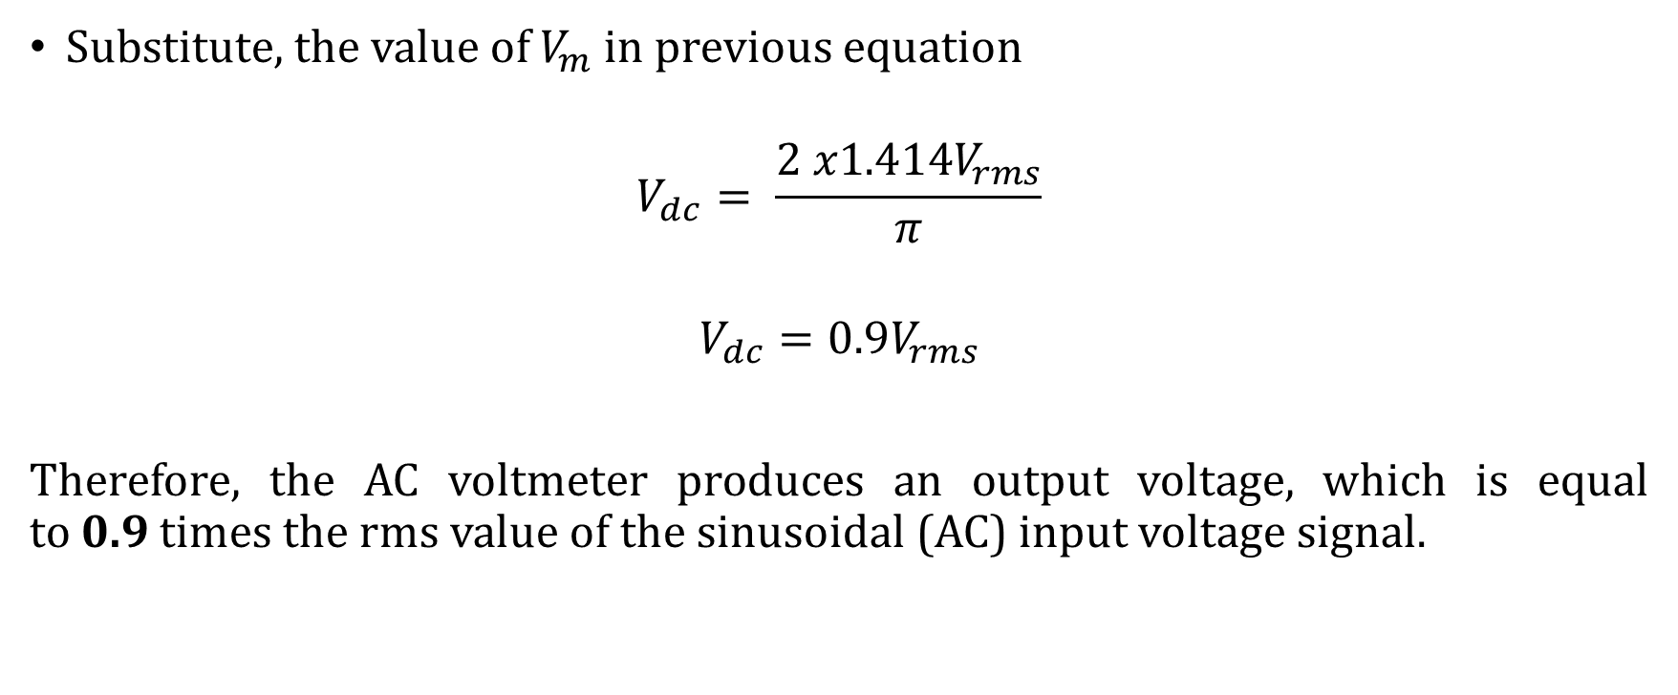
AC Voltmeters
Substitute, the value of $V_{m}$ in previous equation
$$V_{dc}= \frac{2{ x1.414V}_{rms}}{π}$$
$$V_{dc}=0.9V_{rms}$$
Therefore, the AC voltmeter produces an output voltage, which is equal to 0.9 times the rms value of the sinusoidal (AC) input voltage signal.

Slide 32
DC Ammeters
Current is the rate of flow of electric charge.
If this electric charge flows only in one direction, then the resultant current is called Direct Current (DC).
The instrument, which is used to measure the Direct Current called DC ammeter.
If we place a resistor in parallel with the Permanent Magnet Moving Coil (PMMC) galvanometer, then the entire combination acts as DC ammeter.
The parallel resistance, which is used in DC ammeter is also called shunt resistance or simply, shunt.
The value of this resistance should be considered small in order to measure the DC current of large value.

Slide 33
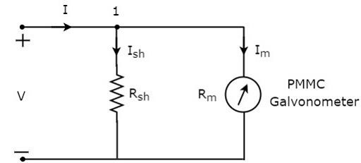
DC Ammeters
The circuit diagram of DC ammeter
We have to place this DC ammeter in series with the branch of an electric circuit, where the DC current is to be measured.
The voltage across the elements, which are connected in parallel is same.

Slide 34
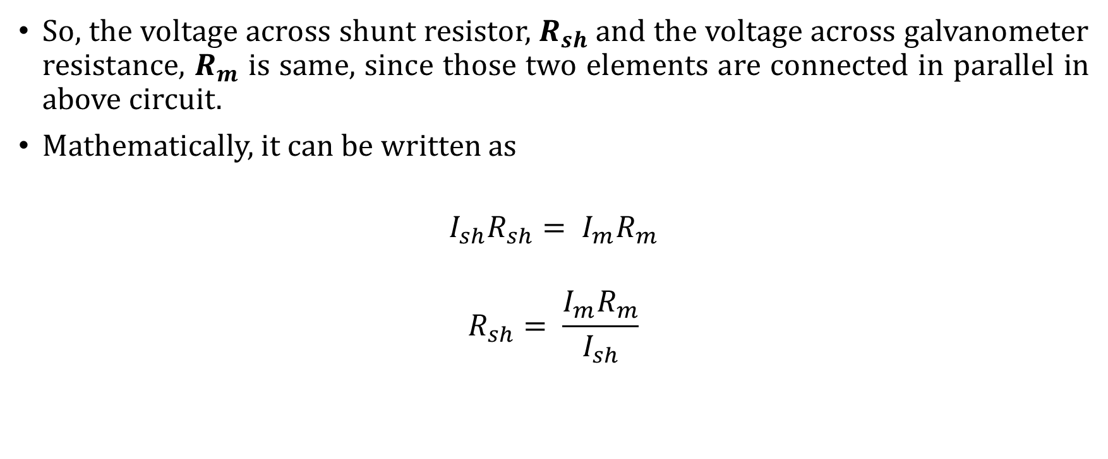
DC Ammeters
So, the voltage across shunt resistor, $R_{sh}$ and the voltage across galvanometer resistance, $R_{m}$ is same, since those two elements are connected in parallel in above circuit.
Mathematically, it can be written as
$$I_{sh}R_{sh}= I_{m}R_{m}$$
$$R_{sh}= \frac{I_{m}R_{m}}{I_{sh}}$$

Slide 35


DC Ammeters
The KCL equation at node 1 is
$$−I+I_{sh}+I_{m}=0$$
$$I_{sh}=I−I_{m}$$
substitute the value of $I_{sh}$
$$R_{sh}= \frac{I_{m}R_{m}}{I−I_{m}}$$
$$R_{sh}= \frac{R_{m}}{\frac{I}{I_{m}}−1}$$
Where,
$R_{sh}$ is the shunt resistance
$R_{m}$ is the internal resistance
of galvanometer
$I$is the total Direct Current that
is to be measured
$I_{m}$ is the full scale deflection current

Slide 36
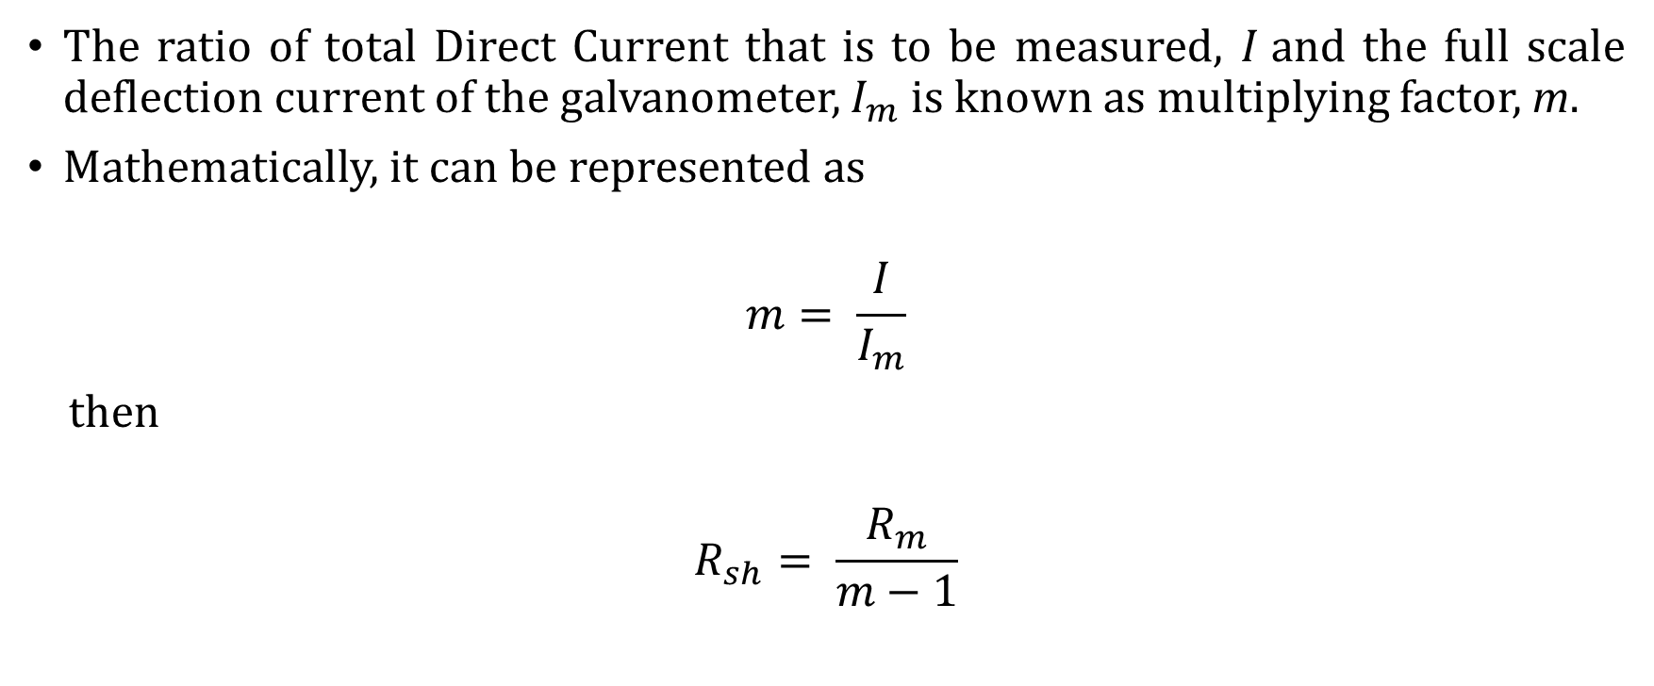
DC Ammeters
The ratio of total Direct Current that is to be measured, $I$and the full scale deflection current of the galvanometer, $I_{m}$ is known as multiplying factor, m.
Mathematically, it can be represented as
$$m= \frac{I}{I_{m}}$$
then
$$R_{sh}= \frac{R_{m}}{m−1}$$

Slide 37
DC Ammeters
Multi Range DC Ammeter
If we want to use the DC ammeter for measuring the Direct Currents of multiple ranges, then we have to use multiple parallel resistors instead of single resistor and this entire combination of resistors is in parallel to the PMMC galvanometer.

Slide 38
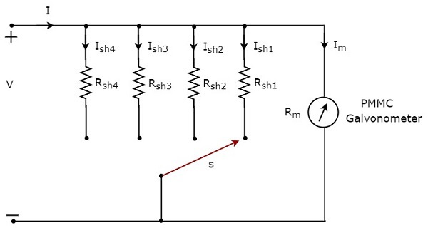
DC Ammeters
The circuit diagram of multi range DC ammeter

Slide 39
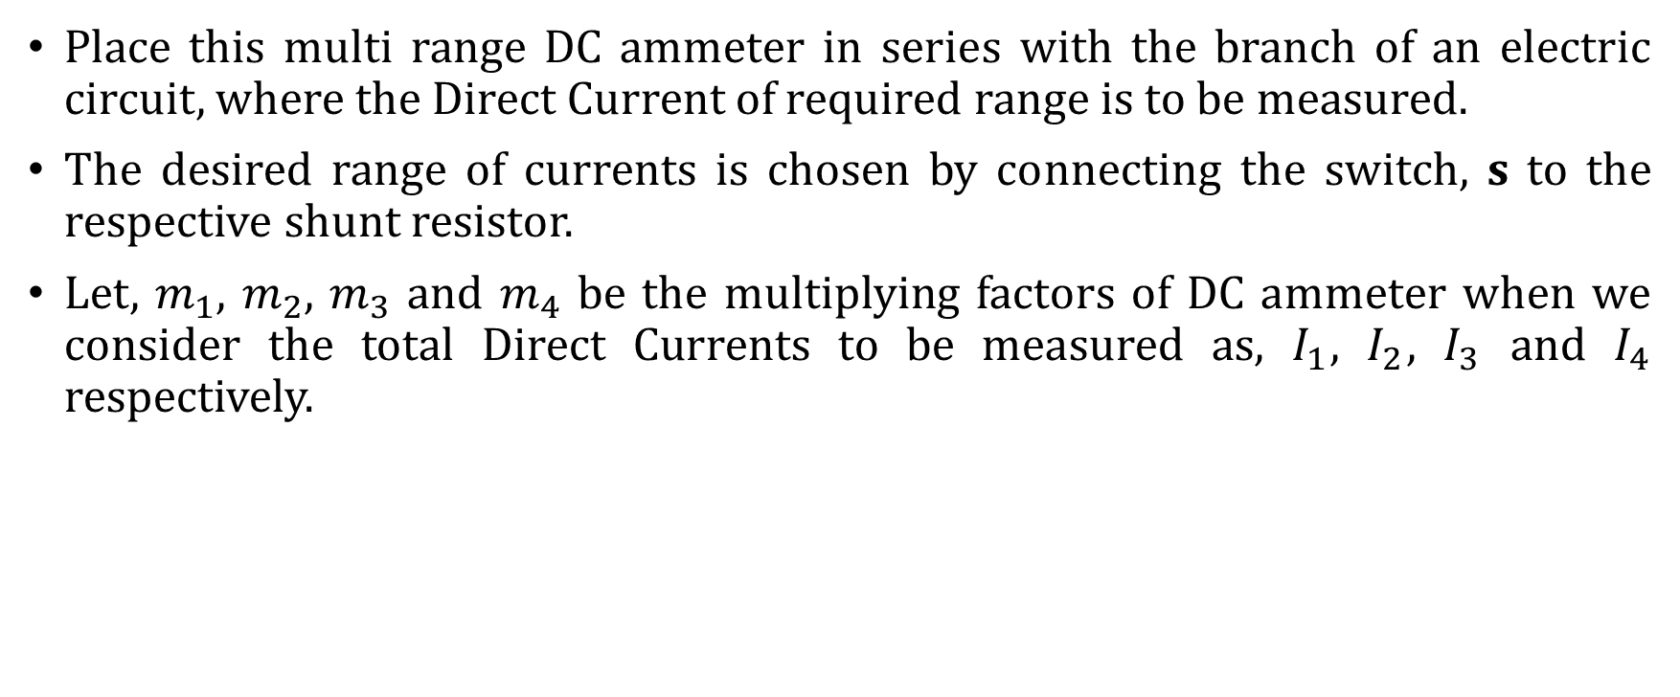
DC Ammeters
Place this multi range DC ammeter in series with the branch of an electric circuit, where the Direct Current of required range is to be measured.
The desired range of currents is chosen by connecting the switch, s to the respective shunt resistor.
Let, $m_{1}$, $m_{2}$, $m_{3}$ and $m_{4}$ be the multiplying factors of DC ammeter when we consider the total Direct Currents to be measured as, $I_{1}$, $I_{2}$, $I_{3}$ and $I_{4}$ respectively.

Slide 40

DC Ammeters
Following are the formulae corresponding to each multiplying factor.
$$m_{1}= \frac{I_{1}}{I_{m}} m_{3}= \frac{I_{3}}{I_{m}}$$
$$m_{2}= \frac{I_{2}}{I_{m}} m_{4}= \frac{I_{4}}{I_{m}}$$

Slide 41

DC Ammeters
Following are the formulae corresponding to these four resistors.
$$R_{sh1}= \frac{R_{m}}{m_{1}−1}$$
$$R_{sh2}= \frac{R_{m}}{m_{2}−1}$$
$$R_{sh3}= \frac{R_{m}}{m_{3}−1}$$
$$R_{sh4}= \frac{R_{m}}{m_{4}−1}$$

Slide 42
AC Ammeter
Current is the rate of flow of electric charge. If the direction of this electric charge changes regularly, then the resultant current is called Alternating Current (AC).
The instrument, which is used to measure the Alternating Current that flows through any branch of electric circuit is called AC ammeter.
Example − Thermocouple type AC ammeter.

Slide 43
AC Ammeter
Thermocouple type AC ammeter
If a Thermocouple is connected ahead of PMMC galvanometer, then that entire combination is called thermocouple type AC ammeter.
The block diagram of thermocouple type AC ammeter
AC input current
Meter reading output
PMMC galvanometer
Thermocouple

Slide 44
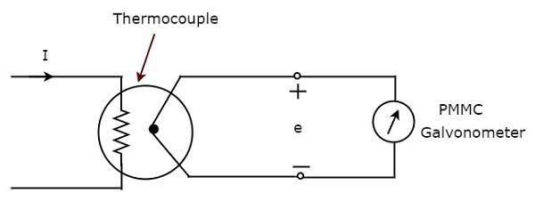
AC Ammeter
The circuit diagram of thermocouple type AC ammeter
Thermocouple generates an EMF, e, whenever the Alternating Current, I flows through heater element.

Slide 45
AC Ammeter
This EMF, e is directly proportional to the rms value of the current, I that is flowing through heater element.
So, we have to calibrate the scale of PMMC instrument to read rms values of current.

Slide 46
QUESTIONS
???

